Slide 1
Application Modeling and Automation
with Morphir & Dapr

Slide 2
Application Development!
Developer value
Turn business concepts into computer concepts
Make it run

Slide 3
Enterprise Reality
Developer value
Developer effort
Turn business concepts into computer concepts
Make it run
Code to frameworks & libraries
Conform to regulations, standards, and blueprints
Documentation
Evolve technology
Ensure the code does what it’s supposed to
Hygiene
Monitoring
Security & vulnerability remediation
Supportability
Testing
Audit
Plug into firm infrastructure
Evolution & future readiness
Telemetry, metrics, and observability

Slide 4
What if…
Let developers focus on this:
Automate this:
Turn business concepts into computer concepts
Make it run
Code to frameworks & libraries
Conform to regulations (i.e., Policy 2.0)
Ensure the code does what it’s supposed to
Keep documents up-to-date
Hygiene & keeping tech up-to-date
Follow blueprints and best practices
Monitoring
Security & vulnerability remediation
Supportability
Testing
Audit
Plug into firm infrastructure (i.e., API Gateway)
Evolution & future readiness (i.e., cloud)
Telemetry, metrics, and observability (i.e., Backtrace)

Slide 5
morphir
logic interchange
morphir core: Intermediary Language (IR)
morphir tools: Parsers & Processors
quickly: Business → Software
community: Ecosystem
https://morphir.finos.org

Slide 6
morphir goals
Share
Translate
Store
Visualize
Automation
Correctness
Knowledge
Community

Slide 7
morphir flow
Design
Generate
Run

Slide 8


Optimize the Development Pipeline
Capture business specs
Architect solution
Code
Build
Test
Deploy
Now:
Capture business specs
Architect solution
Code
Build
Test
Deploy
Goal:

Slide 9
Request
Create Deal - As a client, I want to instruct to record a new deal for a quantity of a product at a specified price…
Close Deal - As a client, I want to instruct to close an existing deal…

Slide 10

Request
Create Deal - As a client, I want to instruct to record a new deal for a quantity of a product at a specified price…
Close Deal - As a client, I want to instruct to close an existing deal…

Slide 11
Result
As a client, I want to know how my instructions were processed…
As an interested party, I want to be notified of any deal activity…
As a regulator, I want to ensure there’s a temporal system of record for all deal activity…

Slide 12
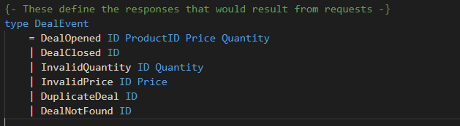
Result
As a client, I want to know how my instructions were processed…
As an interested party, I want to be notified of any deal activity…
As a regulator, I want to ensure there’s a temporal system of record for all deal activity…

Slide 13
State
As a client, I want the state of all of my deals to be accessible at any time…
As a system owner, I want to ensure that deal state is resilient to process restarts…

Slide 14
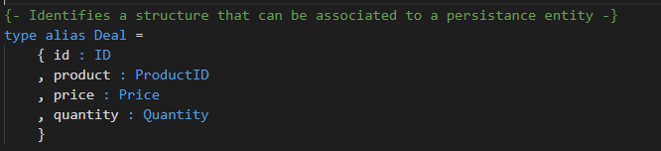
State
As a client, I want to know how my instructions were processed…
As an interested party, I want to be notified of any deal activity…
As a regulator, I want to ensure there’s a temporal system of record for all deal activity…

Slide 15
Logic
As a client, I want to know how my instructions were processed…
As an interested party, I want to be notified of any deal activity…
As a regulator, I want to ensure there’s a temporal system of record for all deal activity…

Slide 16
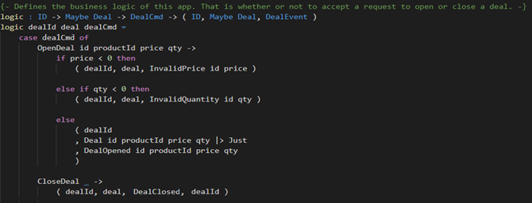
Logic
As a client, I want to know how my instructions were processed…
As an interested party, I want to be notified of any deal activity…
As a regulator, I want to ensure there’s a temporal system of record for all deal activity…

Slide 18
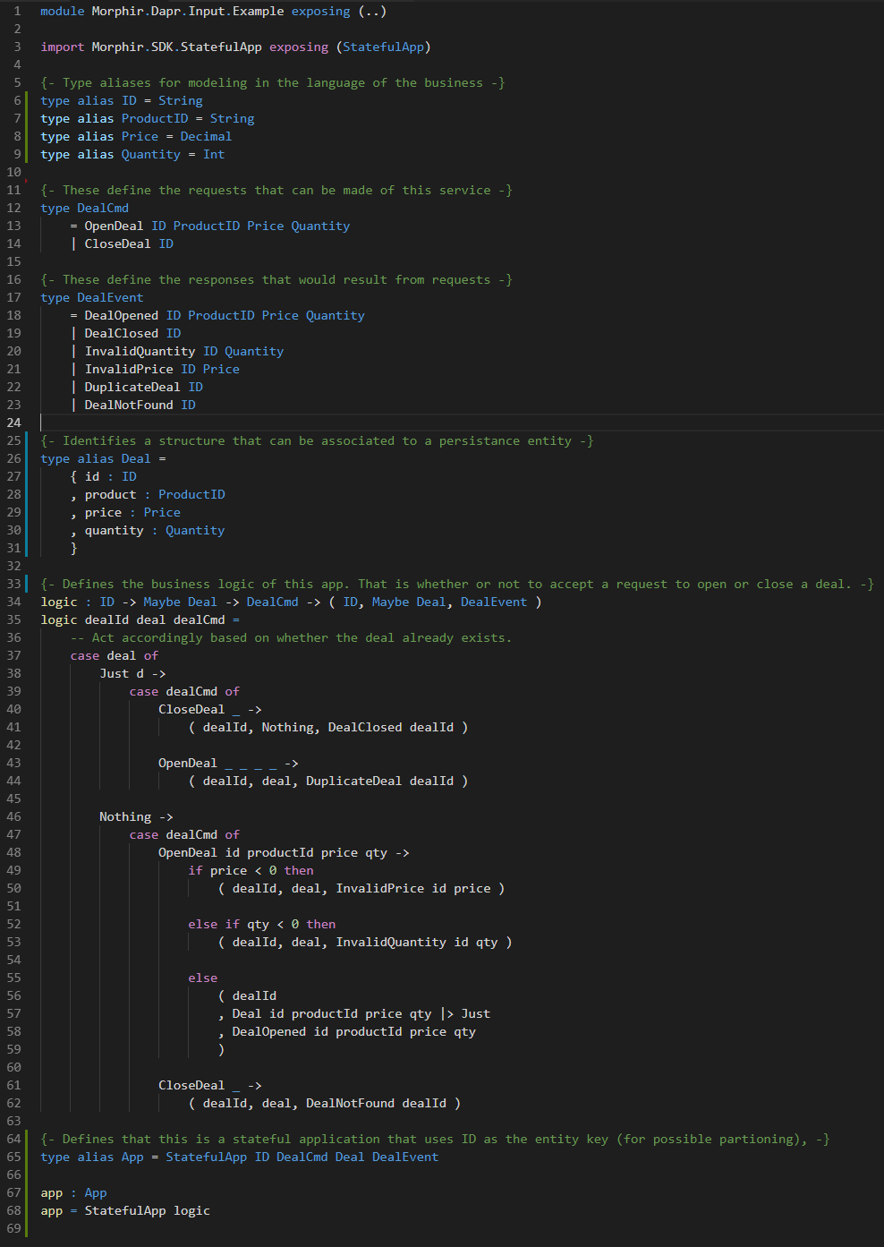
What we automated
Code
JSON serialization
Dapr
Code
JSON serialization
Dapr
Code
Persistence
Dapr
Code
REST binding
Dapr

Slide 19
What else could we automate?
Code
JSON serialization
Observability & telemetry
Policy 2.0 Data dictionary & lineage
Documentation & audit
Service Discovery
OpenAPI / API Gateway
GraphQL
Schema registry
Cloud & security Blueprints
Contract-Driven Development full verification
Tests
Hygiene & Vulnerability remediation
Firm-wide Performance optimizations
Cloud readiness
Future platforms…
Code
JSON serialization
Kafka Publish
Code
Persistence
Code
REST binding

Slide 20
Dapr + Morphir
Dapr
Powerful runtime
Does the heavy lifting
Morphir
Enshrines business knowledge
Evolution ready
Live Documentation
Full data lineage
Portable logic

Slide 21
Optimize the Development Pipeline
Capture business specs
Architect solution
Code
Build
Test
Deploy
Now:
Capture business specs
Architect solution
Code
Build
Test
Deploy
Goal:

Slide 22
What’s Next?
Community
By developers for developers
Open-source
https://morphir.finos.org
https://dapr.io

